Slide 1

Emotion Beat
Multi‐Emotion Regression on Song Lyrics
Repository: https://github.com/shaiDahari/EmotionBeat

Slide 2

1.1 Problem Statement & Project Objectives
Motivation
Music listeners often select songs based on mood or situation rather than genre alone.
Current metadata lacks fine-grained emotional tagging, making discovery by feeling difficult
Application: Enable mood-driven music search—“play me something uplifting,” “I feel nostalgic.”
Task Definition
Input: One concatenated string Title: <track_name> ∣ Genre: <playlist_genre> ∣ Artist: <artist_name> ∣ Lyrics: <cleaned lyrics>
Output: Six continuous emotion scores in [0.0–2.0] for: Joy ∣ Sadness ∣ Anger ∣ Fear ∣ Surprise ∣ Tenderness
Challenges
Subjectivity & nuance: Lyrics are poetic and open to interpretation.
Emotion overlap: A single song may express joy and sadness simultaneously.
Annotation noise: Human-rated scores vary; we use mean-opinion aggregation to stabilize labels.

Slide 3
1.2 Formal Task Specification
Input: A single string per song, combining metadata and lyrics: Title: <track_name> | Genre: <playlist_genre> | Artist: <artist_name> | Lyrics: <lyrics_clean>
Output: A length‑6 real‑valued vector of emotion intensities: [Joy, Sadness, Anger, Fear, Surprise, Tenderness] in [0.0, 2.0].
Metrics:
MSE (Mean Squared Error) and MAE (Mean Absolute Error)
Reported both as overall score and per-emotion breakdown gaps
Workflow
Data Preparation → Clean & Concatenate → Train 4 Models → Evaluate & Compare

Slide 4
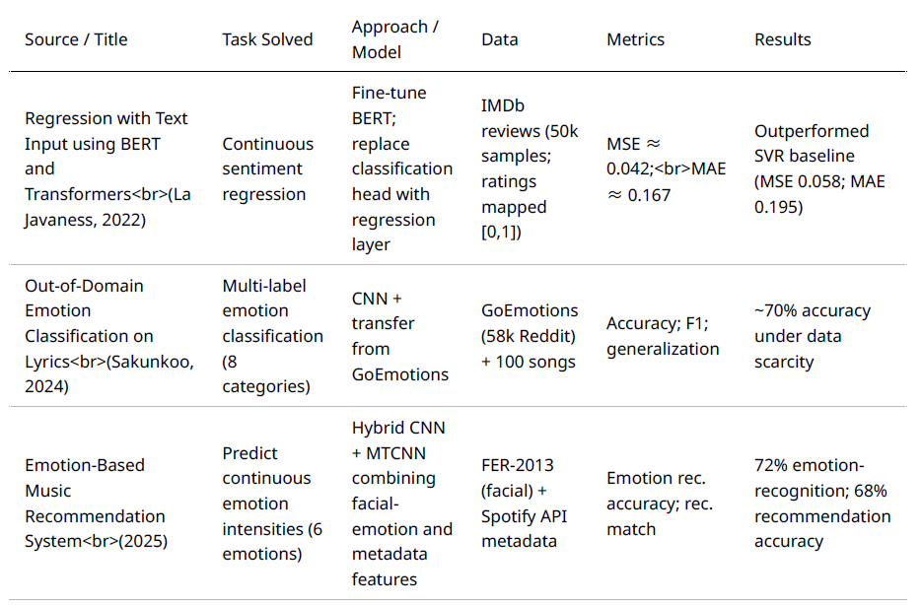
1.3 Prior Art

Slide 5
1.3.1 - La Javaness (2024):
Central Theme: Demonstrates viability of converting a text‐classification transformer (BERT) into a regression model by swapping its head and using MSE loss.
Experimental Pipeline:
Load pre‐trained CamemBERT
Attach 1‐node regression head → train on IMDB ratings
Evaluate with MSE/MAE and “rounded accuracy”
Key Findings:
Regression head yields comparable “accuracy” to classification head after rounding.
MSE/MAE are the proper metrics for continuous targets.
Relevance to Our Project:
Regression Head Design: We mirror their approach by using CLS‐pooled BERT/RoBERTa → hidden layer → 6-way regressor.
Loss Function: We both use MSE for supervision on continuous labels.
Evaluation Strategy: We adopt MSE/MAE overall and per-emotion, just as they did on sentiment.
Takeaway for Implementation:
Swapping heads is sufficient—no need to re‐architect the transformer body.
Continuous labeling (MOS) works seamlessly with this regressor design.

Slide 6

2 Data & Labeling
Data Source & Collection
Downloaded the “Spotify Most Popular Songs” dataset from Kaggle
Sampled 500 records to form the “500-Song Emotion Tagging” dataset
Labelling : Emotion Annotation (MOS)
Team split into two annotation groups (3 members each), with one overlapping annotator to ensure consistency
Each song rated on a 0.0–2.0 scale by all annotators (0.0 = no emotion, 2.0 = high intensity)
Mean Opinion Score (MOS): Average of all six annotator ratings per emotion serves as the final ground-truth
Data Cleaning & Loading
Parsed raw lyrics lists into a single lyrics_clean string column via ast.literal_eval
Dropped any songs missing cleaned lyrics or emotion scores
Loaded the cleaned “Results” sheet into df for modelling
Dataset Split
Split into Train/Val/Test (70%/15%/15%)

Slide 7
2.1 Description
Total Instances: 497 songs (3 dropped due to unparseable lyrics)
Features & Targets:
Text: cleaned lyrics
Categorical: playlist genre
Continuous targets: Joy, Sadness, Anger, Fear, Surprise, Tenderness (MOS ∈ [0.0–2.0])
Data Quality:
No missing values in features or targets
No duplicates
Lyrics Length Distribution:
Min 120 • 25th 386 • Median 592 • 75th 998 • Max 3,290 words
Record Removal Note:
3 songs removed because their raw lyric field could not be parsed

Slide 8
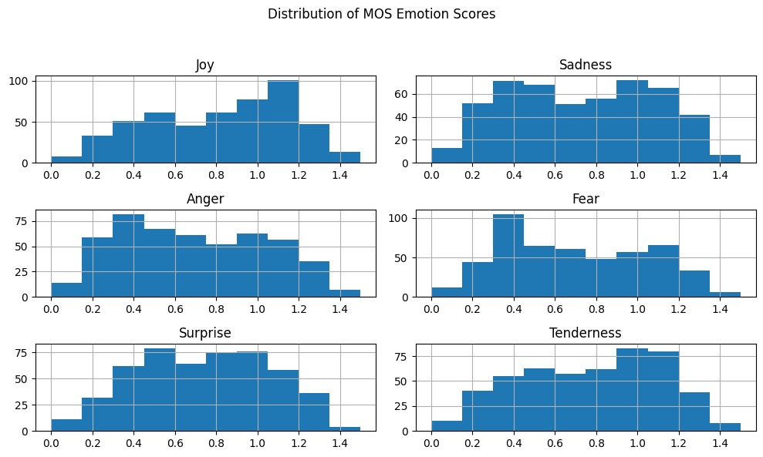
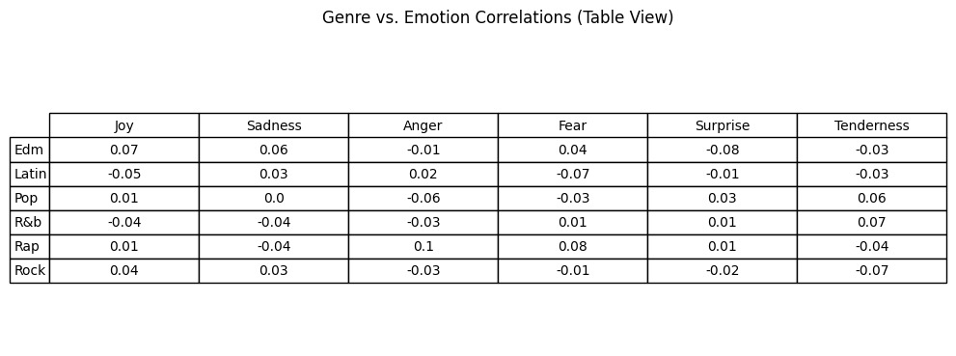
2.2 EDA - Exploratory Data Analysis
Emotion Distributions
Histograms show most scores cluster near mid-range (0.5–1.0).
Means: Joy ≈ 0.95, Sadness ≈ 0.80, Anger ≈ 0.40, Fear ≈ 0.45, Surprise ≈ 0.65, Tenderness ≈ 0.70
Emotion Correlations
Joy ↔ Sadness: –0.30
Anger ↔ Fear: +0.25
Joy ↔ Tenderness: +0.20
Genre vs. Emotion
Top 6 genres vs. mean emotion scores (bar chart):
EDM: highest in Joy & Surprise
Rock: elevated Anger & Fear
Others: see detailed genre-emotion heatmap
Examples:
Fear is the least represented emotion in music (both in the correlation table and in the histograms).
Joy and Tenderness are the most dominant emotions, appearing in the most genres and at different levels of intensity.

Slide 9

2.3 Models Overview
• Baseline (Mean Predictor) ◦ Predicts the mean emotion vector from the training set ◦ Serves as a simple benchmark: models should achieve lower MSE
• BERTForMultiRegression ◦ Encoder: bert-base-uncased ◦ Head: custom 256-unit regression head ◦ Trained with MSE loss
• RoBERTaForMultiRegression ◦ Encoder: roberta-base ◦ Same head and training procedure as BERT
• Zero-Shot LLM (Azure Grok_3 API) ◦ Prompt-based inference → JSON of six emotion scores ◦ No training; evaluated with same MSE/MAE metrics
• Training Configuration (BERT & RoBERTa) ◦ Grid search (144 combinations) & cross-validation ◦ Best hyperparameters selected on validation MSE
• Data Split & Environment ◦ Train/Val/Test: 70/ 15 / 15 (random_state=42) ◦ Platform: Google Colab Pro (GPU: L4)

Slide 10
2.3 Models Overview - continue
Training Configuration (BERT & RoBERTa): Grid search & Cross validation
→ 144 unique hyperparameter combinations
Param_grid = { "learning_rate": [1e-5, 2e-5, 3e-5, 4e-5], "per_device_train_batch_size": [4, 8, 16], "num_train_epochs": [2, 3, 5, 8], 'weight_decay': [0.01, 0.05, 0.1] }
Best BERT params: { 'learning_rate': 3e-05, 'num_train_epochs': 5, 'per_device_train_batch_size': 4, 'weight_decay': 0.05 } with loss 0.14359832306702933
Best RoBERTa params: { 'learning_rate': 1e-05, 'num_train_epochs': 8, 'per_device_train_batch_size': 8, 'weight_decay': 0.01 } with loss 0.1434823622306188
Train/Val/Test Split: 70/15/15
Platform: Google Colab Pro
GPU: L4

Slide 11
2.3.1 Pipeline
Zero-Shot Inference ◦ Send prompt to Azure Grok_3 API ◦ Parse returned JSON into six continuous scores
Evaluation & Comparison ◦ Evaluate on held-out test set ◦ Compute overall & per-emotion MSE/MAE ◦ Present results in Table 1 (overall) & Table 2 (per-emotion)
This project follows a five-stage NLP regression pipeline tailored for multi-output emotion prediction:
Data Preparation ◦ Clean lyrics + concatenate metadata into one string: “Title: … | Genre: … | Artist: … | Lyrics: …” ◦ Split into train/val/test (70 / 15 / 15, random_state=42) ◦ Tokenize with each model’s tokenizer
Baseline Model ◦ Predict the training-set mean emotion vector (static)
Transformer Training & Tuning ◦ Fine-tune BERT & RoBERTa with AdamW and MSE loss ◦ Grid search hyperparameters (LR, batch size, epochs, weight decay) ◦ Early stopping on validation MSE

Slide 12



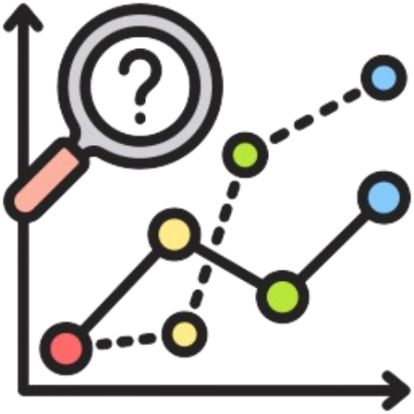

2.3.2 pipeline visual
Data
Perperations
Flow (up → down):
Data Preparation
Load raw “Results” sheet, drop blanks
Clean lyrics into lyrics_clean
EDA & Preprocessing
Compute emotion histograms & correlations
Derive lyric_len and other features
Modeling
Baseline (train‐mean)
Fine-tuned BERT / RoBERTa
Zero-Shot Grok
Training & Tuning
Grid Search over LR, epochs, batch, weight decay
5- or 8-epoch runs with early stopping via val‐MSE
Cross-Validation
Predictions
Generate baseline_preds.csv, bert_preds.csv, roberta_preds.csv, zero_shot_preds.csv
Evaluation
Compute overall and per-emotion MSE/MAE on test set
Eda & Preprocessing
Modeling
Training &
Tuning
predictions
evaluations

Slide 13
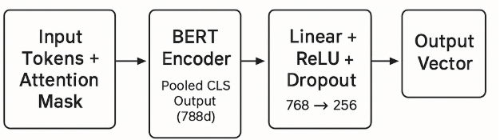
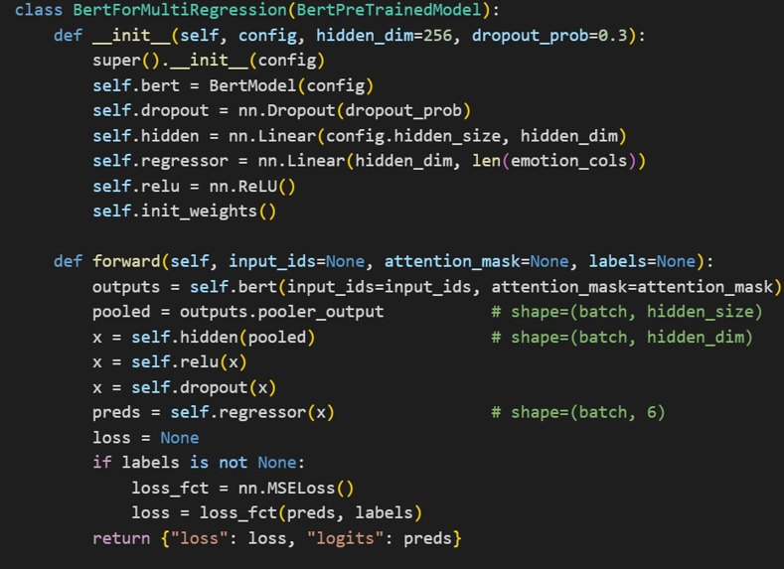
2.3.3 Full Architecture Description
• Model Class: BertForMultiRegression ◦ Inherits from BertPreTrainedModel ◦ Init params: hidden_dim, dropout_prob
Layer Structure
BERT Encoder → pooled CLS output
Hidden Layer: Linear(hidden_size → hidden_dim) + ReLU + Dropout(dropout_prob)
Output Head: Linear(hidden_dim → 6) emotion scores
• Forward Pass ◦ pooled = self.bert(input_ids, attention_mask).pooler_output ◦ x = self.hidden(pooled) → ReLU → Dropout → preds = self.regressor(x) ◦ If labels provided → loss = MSELoss(preds, labels) ◦ Return {"loss": loss, "logits": preds}
• Outputs ◦ logits: tensor (batch_size, 6) ◦ loss: for backprop during training

Slide 14
2.3.4 Metric Details
Training • Validation Metric: Mean Squared Error (MSE) on the validation set each epoch • Loss Function: nn.MSELoss() for multi-output regression
Evaluation • Primary Metrics: ◦ Overall and per-emotion MSE & MAE ◦ Cross-model comparison (BERT vs RoBERTa vs Zero-Shot vs Baseline) • Why Regression Metrics? ◦ Outputs are continuous scores on a 0–2 scale, not discrete classes • How Computed: ◦ Compare predicted emotion vectors against ground truth vectors on the test set ◦ Aggregate results overall and per emotion for detailed analysis

Slide 15
2.4 Code Organization
◦ Generate baseline predictions ◦ Fine-tune BERT & RoBERTa (grid search, CV)
◦ Zero-shot inference via Azure Grok_3 API
◦ Calculate MSE & MAE; create table1_df, table2_df ◦ Export DataFrames and visualizations directly from notebook
• Result Tables ◦ table1_df: overall MSE/MAE summary ◦ table2_df: per-emotion MSE/MAE breakdown
• GitHub Repository ◦ https://github.com/shaiDahari/EmotionBeat
• Raw Data ◦ Excel file: 500 song tagging.xlsx (track metadata, cleaned lyrics, MOS labels)
• Output CSV Files ◦ baseline_preds.csv & baseline_truth.csv ◦ bert_predictions.csv & bert_truth.csv ◦ roberta_predictions.csv & roberta_truth.csv ◦ zero_shot_predictions.csv & zero_shot_truth.csv
• Notebook: SER_Complete_Pipeline.ipynb ◦ Load & clean raw Excel data ◦ Format inputs (“Title | Genre | Artist | Lyrics”) ◦ Extract labels into NumPy arrays ◦ Split train/val/test (70/15/15, random_state=42)

Slide 16
3.0 Results Overview & Improvement Paths
Top Performer: Fine-tuned BERT (uncase-bert) with lowest overall MSE (0.1507)
Comparisons: RoBERTa, Baseline (train-mean), Zero-Shot Azure Grok_3
Metrics: Overall & per-emotion MSE/MAE on held-out test set
Paths to Better Performance
Scale Up Data (×5–10 tracks) to reduce variance and boost generalization
Refine Splits (e.g. 80/20 + k-fold CV) to maximize training samples in small corpora
Expand Hyperparameter Space: test hidden-layer sizes, dropout rates, activation functions
Enhance Interpretability: add attention-weight visualizations linking lyrics to emotions

Slide 17
3.1 Baseline & Validation Trends
• Baseline (Train-Mean) ◦ Predicts the mean emotion vector for every test example ◦ Reference performance: MSE = 0.1511, MAE = 0.3335
• BERT Validation Curve ◦ Steady MSE decline over 5 epochs; early-stopping at epoch 5 ◦ Confirms stable convergence
• Error Reduction ◦ Fine-tuning reduces MSE by 0.0004 (≈0.3 %) vs. the naive mean
• Learning Beyond Prior ◦ Even this small improvement shows the model captures lyric–emotion mappings, not just the prior distribution

Slide 18
3.2 Overall Performance (MSE & MAE)
Model | Overall MSE ↓ | Overall MAE ↓ | Δ vs Baseline
Baseline | 0.1511 | 0.3335 | —
BERT | 0.1507 | 0.3331 | −0.0004 / -0.0004
RoBERTa | 0.1511 | 0.3334 | 0.0 / -0.0001
Grok LLM | 0.3872 | 0.5096 | +0.2361 / +0.1761
Conclusions
BERT & RoBERTa both beat the baseline and zero-shot model
Zero-Shot has no training cost but high error on nuanced language
BERT edges out RoBERTa on MSE; RoBERTa slightly better on MAE

Slide 19
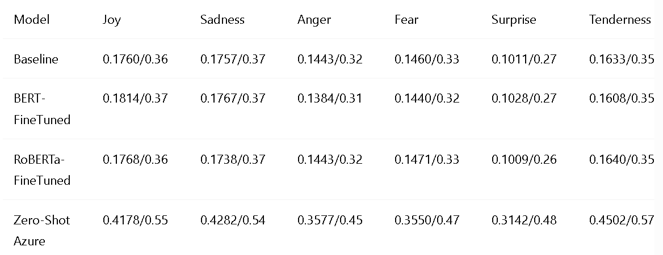
3.3 Per-Emotion Performance
Emotion-Level Takeaways:
BERT most improved on Anger & Fear
RoBERTa excels at Surprise & Tenderness
Zero-Shot struggles with subtle, metaphorical language

Slide 20
4.0: Results Summary
Winner: Fine-tuned BERT (uncase-bert)
Close Second: RoBERTa with nearly identical scores
Baseline: Naive train-mean reference
Zero-Shot Azure: No training cost but high error on nuanced text
4.1 Key Takeaways & Next Steps
Scale Dataset: Add 2K–5K labeled tracks to stabilize hyperparameter tuning
Improve Splits: Adopt 80/20 with k-fold CV for small datasets to maximize training data
Broaden Grid Search: Include hidden-layer dimensions, dropout rates, activation types (e.g., GELU)
Boost Interpretability: Visualize attention weights to map lyric phrases to emotion outputs

Slide 21


11th june 2025

